Slide 1

NBA analysis dashboard
William Reinhold
This Photo by Unknown Author is licensed under CC BY-SA

Slide 2
Background
Aimed to show how NBA teams are built
Can be used to compare various statistics
Broken down at the position and team level

Slide 3
Ethical Considerations
NBA data is publicly available
This data set was downloaded from Kaggle.com, a website for data scientists and others to share large data sets.
Data only included stats that can be scraped for free from the NBA website.

Slide 4
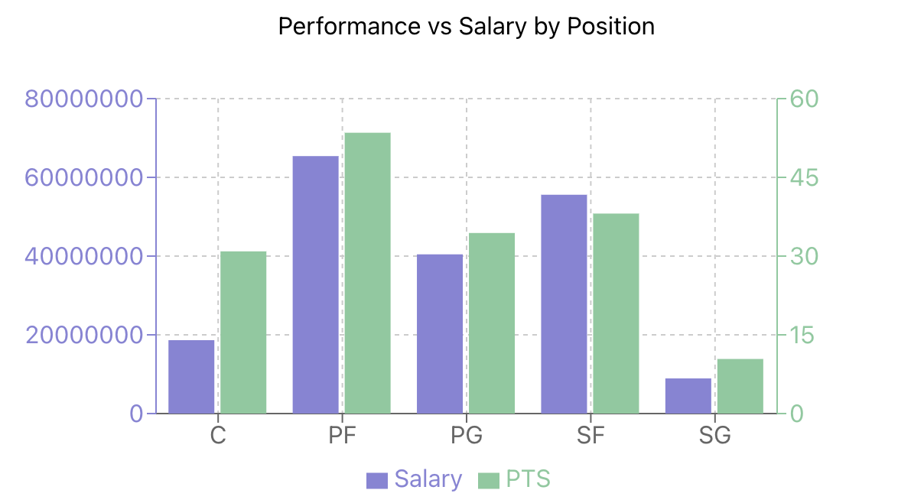
First Graph

Slide 5
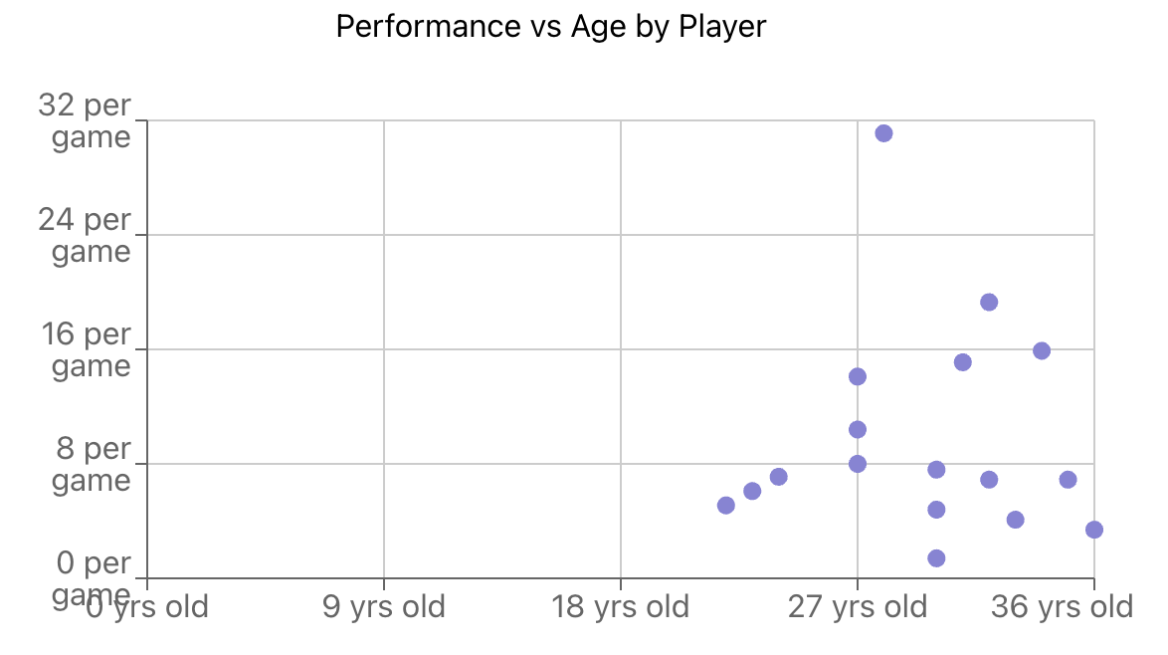
Second graph

Slide 6
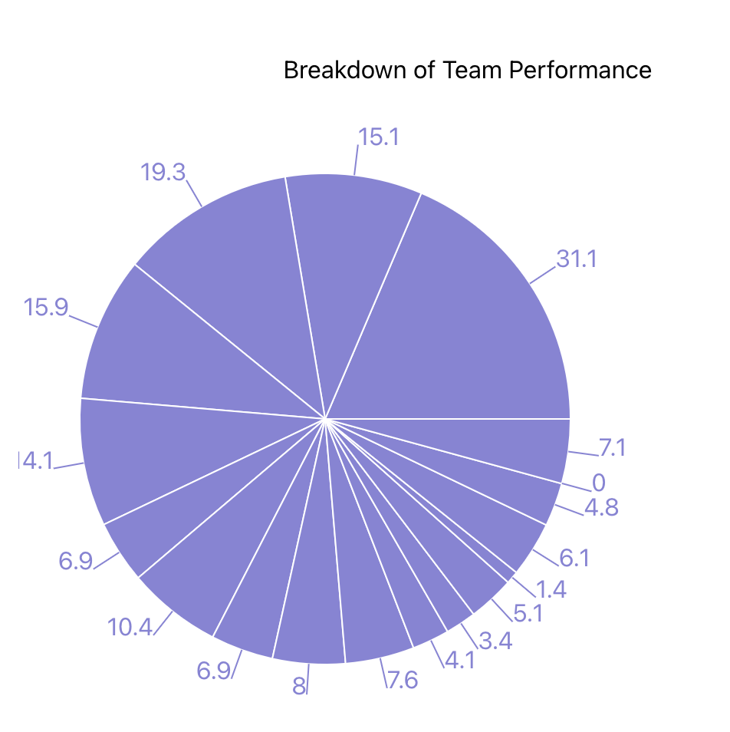
Third Graph

Slide 7
References
Project can be found at https://github.com/wreinhold/nba-analysis-project.
Data is sourced from https://www.kaggle.com/datasets/jamiewelsh2/nba-player-salaries-2022-23-season.
The following websites were used as guides
vitejs.dev
react.dev
recharts.org
mui.com

